Slide 1

PA Voters Analysis
Team Members:
Rajinder Gill, Maria Javier , Julia Nalyvaiko, Maggie Obryk

Slide 2

Project Overview
Why did we choose this topic?
Voting is such a hot topic recently. Pennsylvania is generally considered a battleground state. The presidential campaign 2020 has already started, so the team thought this would be a good topic to look at.
What questions do we want to answer?
What voter groups are most active in the analyzed counties?
How does the active voting population break down according to gender, parties, and the age groups?
Data Source: https://www.pavoterservices.pa.gov/Pages/PurchasePAFULLVoterExport.aspx

Slide 3
Challenges
There are 67 counties in the state of Pennsylvania.
Due to the overwhelmingly large data sets, (from 1919 up to 2018), the team decided to analyze the less populated counties rather than the top 5 dense populations in PA.
Limited access to broader data sets.
Personally Identifiable Information (PII) had to be removed, e.g. names, address
Reports contain many blanks and useless columns

Slide 4
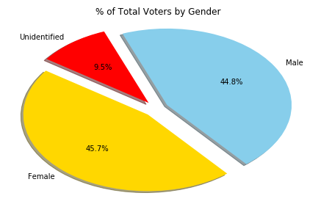
Voters by Gender
The percentage of total voters by gender clearly shows that there is an equal proportion of Female, (45.7%), vs Male, (44.8%), voters, which totals about 90.5% followed by unidentified gender at 9.5%.

Slide 5
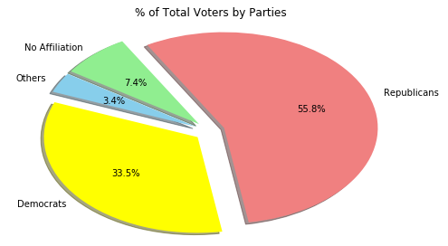
Voters by Parties
The majority of voters appear to be Republicans (55.8%), followed by Democrats (33.5%), Non-Affiliated (7.4%) and Others (3.4%).
Difficulty: Declared party lines were blurred, vague or too varied.
Just a few examples include:
“non-partisan”, “no party”, “no”, “non party”, “not sure”, “none”, “other”.
“Socialist Democrat”, “Socialist”, “Republican Democrat”, “Republican Democratic No Affiliation”
“Spaghetti”, “Squirrel Reform”, “Pirate”, “Pro-Life”

Slide 6
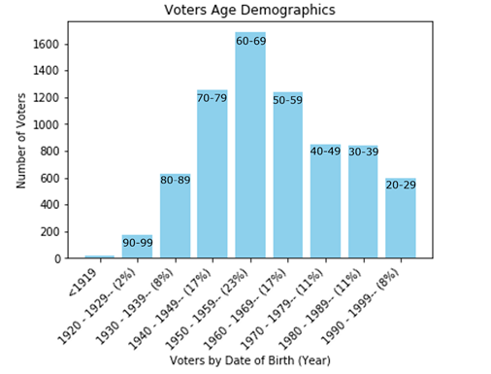
Voters by Age Group
Our peak of voters by the age group falls between ages 60-69 (23%); with secondary groups falling between age 50-59 (17%) and 70-79 (17%) respectively.

Slide 7
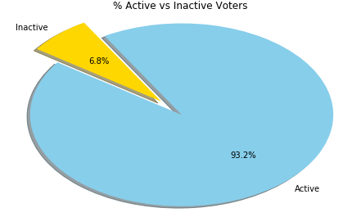
Active vs Inactive Voters
The percentage of all registered active voters is very high at 93.2%. The people in the counties analyzed do vote regularly.

Slide 8
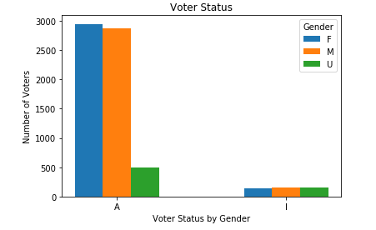
Active vs Inactive Voters
Out of the active vs inactive, there are no differences seen between the genders. There is however, a significant amount of active voters compared to inactive voters.

Slide 9
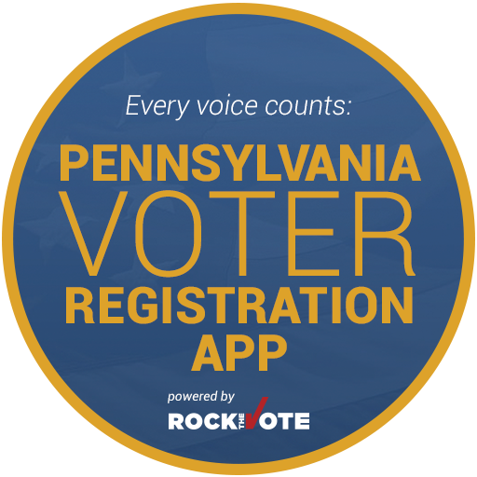
Project Summary
Did we answer our questions? Yes
Active vs inactive voters in the bottom two counties in Pennsylvania
Number of active voters within counties
Voters by gender
Voters by parties
Voters by age group

Slide 10
Q & A
?

